Slide 1
TO RESIST PEER PRESSURE

Slide 2
WOULD YOU RATHER
Read a book
Watch a movie

Slide 3
OBJECTIVES
Review the definition of peer pressure
Discuss why peer pressure can be so challenging to combat
Reflect on how you can make a choice to resist peer pressure

Slide 4
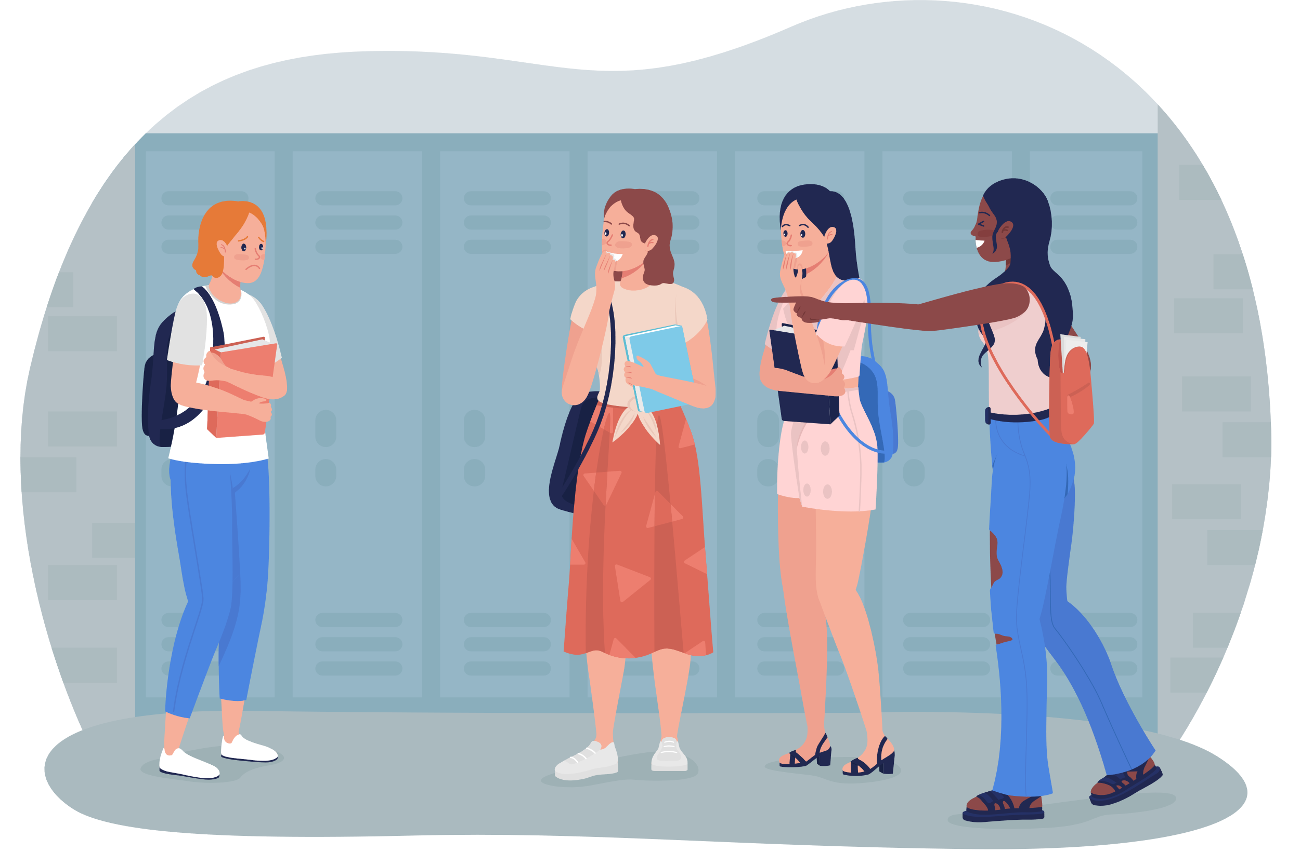
PEER PRESSURE
Peer Pressure is the desire to conform to what others are doing in hopes of feeling accepted or valued by peers.

Slide 5
PEER PRESSURE
Examples of Peer Pressure might include:
Ditching class
Using substances
Stealing
Cheating

Slide 6
DISCUSSION
Have you ever experienced Peer Pressure?

Slide 7
WHY DO WE GIVE IN TO PEER PRESSURE?
There are many reasons why young people are susceptible to peer pressure.
It's natural to want to fit in
Your brain is not yet assessing risks or thinking about consequences
No one wants to feel left out.

Slide 8
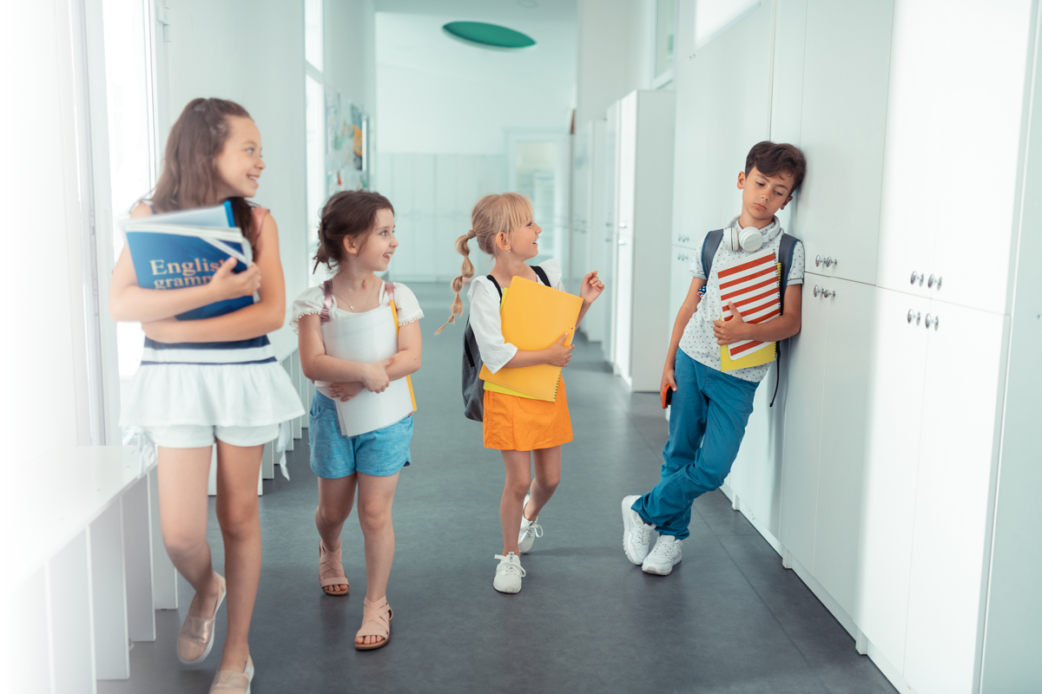
MAKE A CHOICE!
Even though young people are more susceptible to peer pressure…
They still have the power to make a choice to resist!

Slide 9
CHOOSE TO RESIST PEER PRESSURE
Notes:
https://youtu.be/dL5W5-gvlBE

Slide 10
ASK YOURSELF...
Does this feel right for me?
Am I comfortable with this?
What are the consequences of this action?

Slide 11
TRUST YOUR GUT
Make a choice - if you decide you're not comfortable...
Stand up and say no.
Stay firm in your decision.

Slide 12
EVALUATE FRIENDSHIPS
Consider changing your peer group if you feel like your friends are pressuring you to do something you don't want to.
You get to choose your friends.
True friends won't ask you to change or hurt yourself to be accepted.

Slide 13
GIVE YOURSELF SOME GRACE
Remember that dealing with peer pressure is not easy.
You have choices!
Ask for help from someone you trust.
Asking for help is normal.

Slide 14
Do you think it's possible to overcome peer pressure?
Which of these techniques might you use?
DISCUSSION

Slide 15
CHECK OUT
What will you do for yourself today?

Slide 16
Committed to fostering a safe and respectful District, school and community culture where the seeds of peace and justice are sown so that all students and staff can lead safe, purposeful and academically fruitful lives.
Connect with us at bit.ly/LAUSD-HRDE

